Slide 1
Courier Management System
Presentation by
G-51
Salvi Abhilasha Rajendra 219160
Jadhav Pragati Maroti 219075

Slide 2
Introduction:
The Courier management system is web application that helps a courier company or businesses manage their customers' parcels or packages details.
The system stores all the information related to parcel, customers, and staff.
The system has a tracking feature which can help to monitor the movement of the customer's parcel.
The Staff user can manage all the data in the system including managing the branches and staff user.
The Customer can only track a parcel

Slide 3
Modules:
Admin
Dashboard
Add customer and parcel details.
Add branch details.
Update Parcel status..
Parcel List.
Customer List.
Staff List and branch list.
Track Parcel.
Report
Customer
Track Parcel.

Slide 4
Technology:
.
Spring-Boot :
It provides a flexible way to configure java Beans,XML configuration and database transactions.The main goal of the Spring Boot framework is to reduce overall development time and increase efficiency.
React :
React allows developers to create large web applications that can change data, without reloading the page. The main purpose of React is to be fast, scalable, and simple.
Mysql :
Mysql is an open source relational database management system so it gives high performance and strong data protection.

Slide 5
Features:
Admin:
Login:
Admin login using some credentials such as registered email id and password.
Add Customer Detail:
Admin can add all customer details such as Name,Email,Mobileno etc.
Add parcel details:
Admin will add parcel details. The shipping amount is calculated based on weight of parcel and distance from source to destination.

Slide 6
Parcel status:
Admin will update the status of Parcel.
Add Staff:
Admin will add office staff and delivery staff.
Parcel list:
Admin can view information related to parcel which is stored in database
Parcel Tracking:
Customer will be able to track parcel status. Customer will be able to track deliver
using unique tracking id presented to them. Status can be changed by admin.

Slide 7
Staff List:
Admin can view information related to staff.
Customer list:
Admin can view information of customer
Add Branch:
Admin can add branch details .
Branch list:
Admin can view information of all branches added.

Slide 8
Customer:
Track parcel:
When parcel is accepted then mail is sent to Customer.In that mail tracking id and link is sent so that customer and customer Can track parcel using that link.
The couriered items have multiple statuses which are the "Item Accepted by Courier", "Collected", "Shipped", "In-Transit", "Arrived At Destination", "Out for Delivery", "Delivered" and "Unsuccessful Delivery Attempt". These statuses will help to determine the movement of the parcel.
.

Slide 9
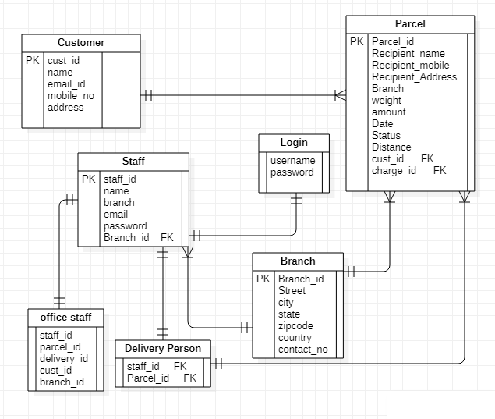
ER Diagram

Slide 10
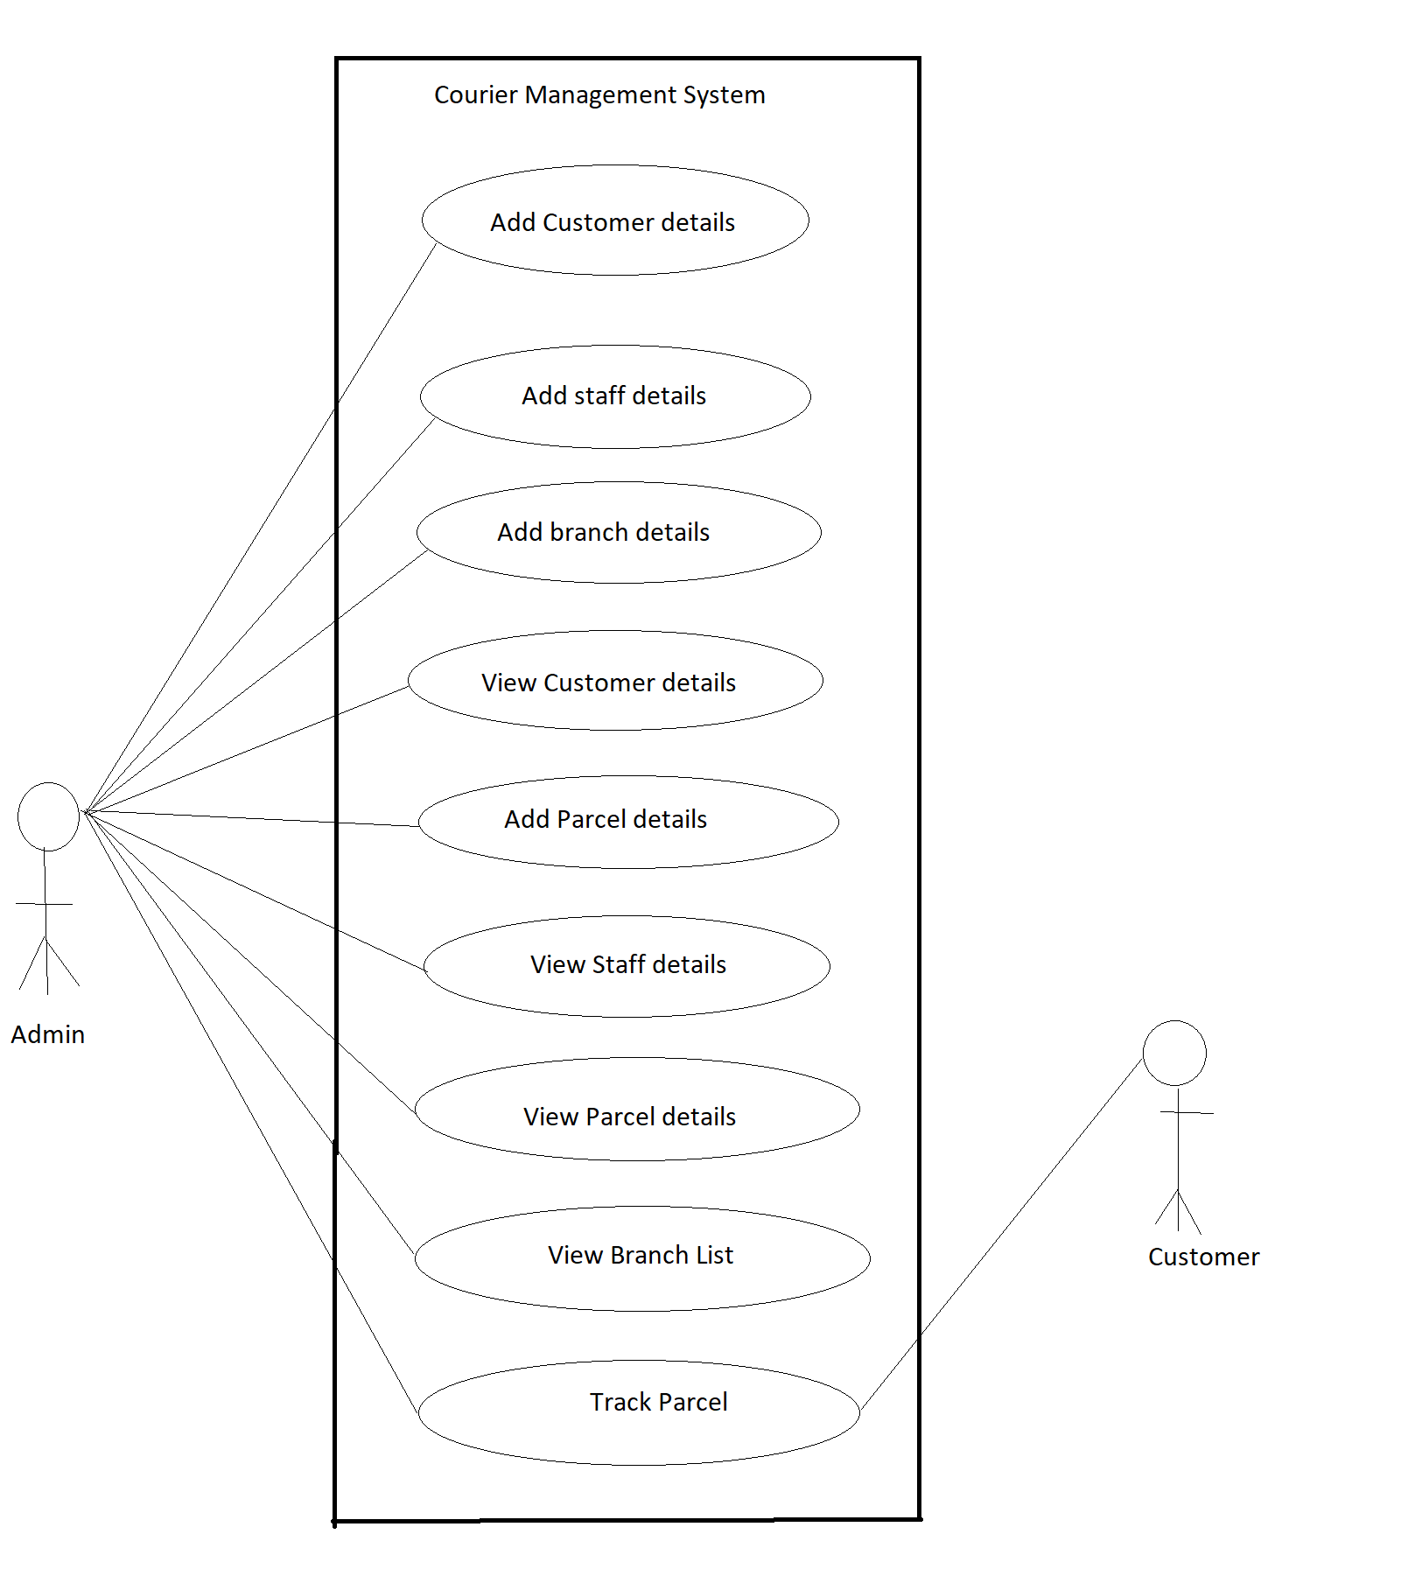
Use Case Diagram

Slide 11
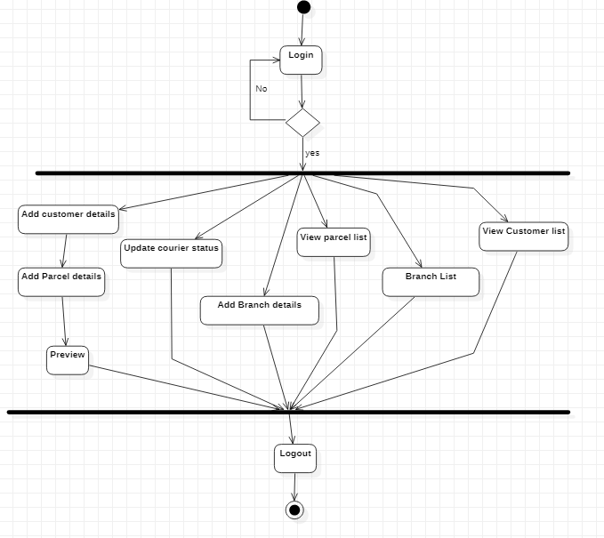
Activity Diagram

Slide 12
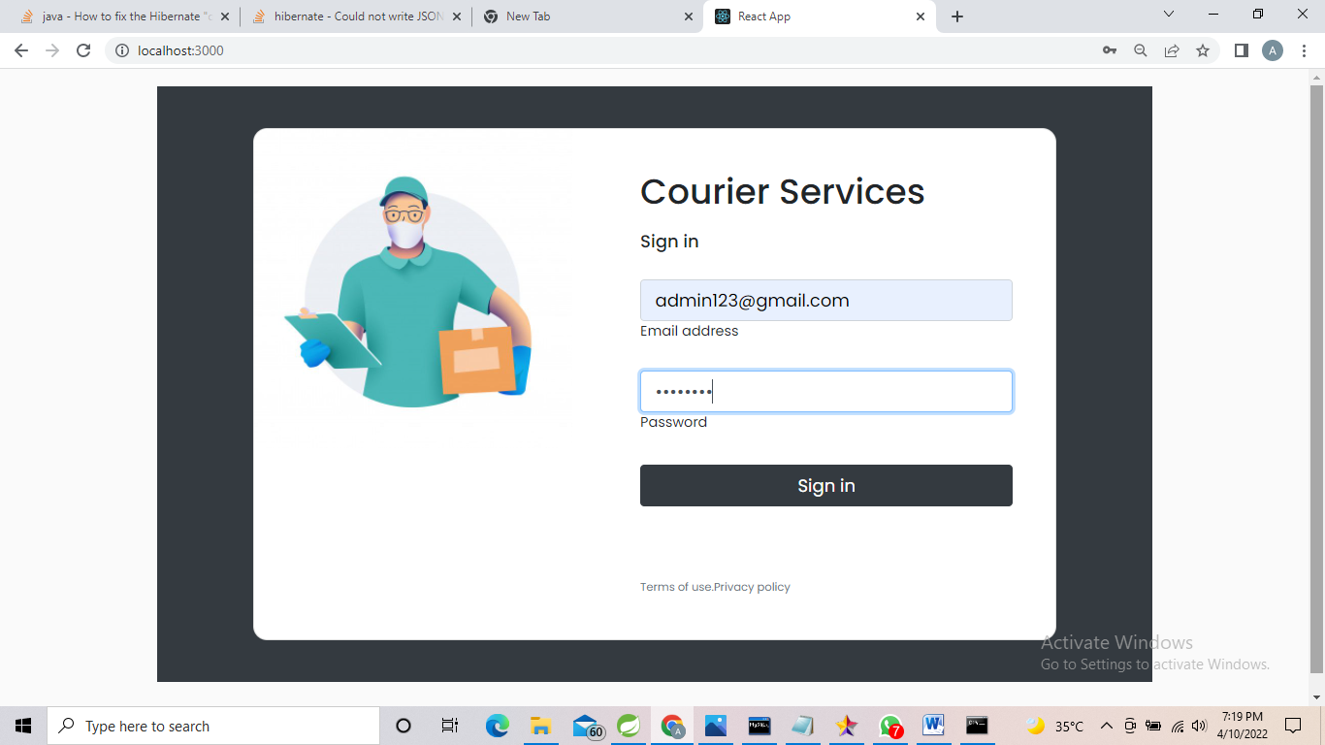
Screenshots:
Login:

Slide 13
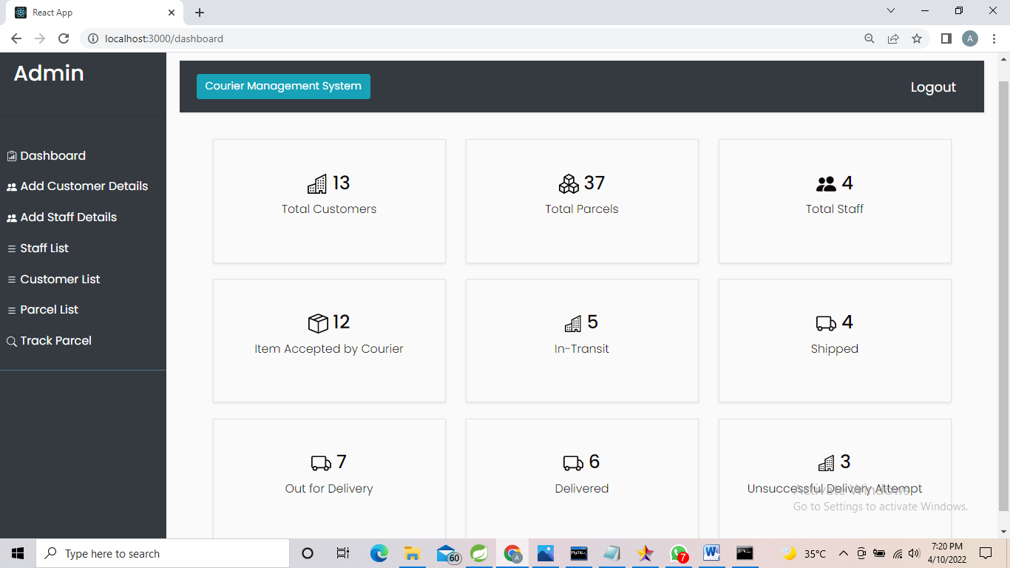
Homepage

Slide 14
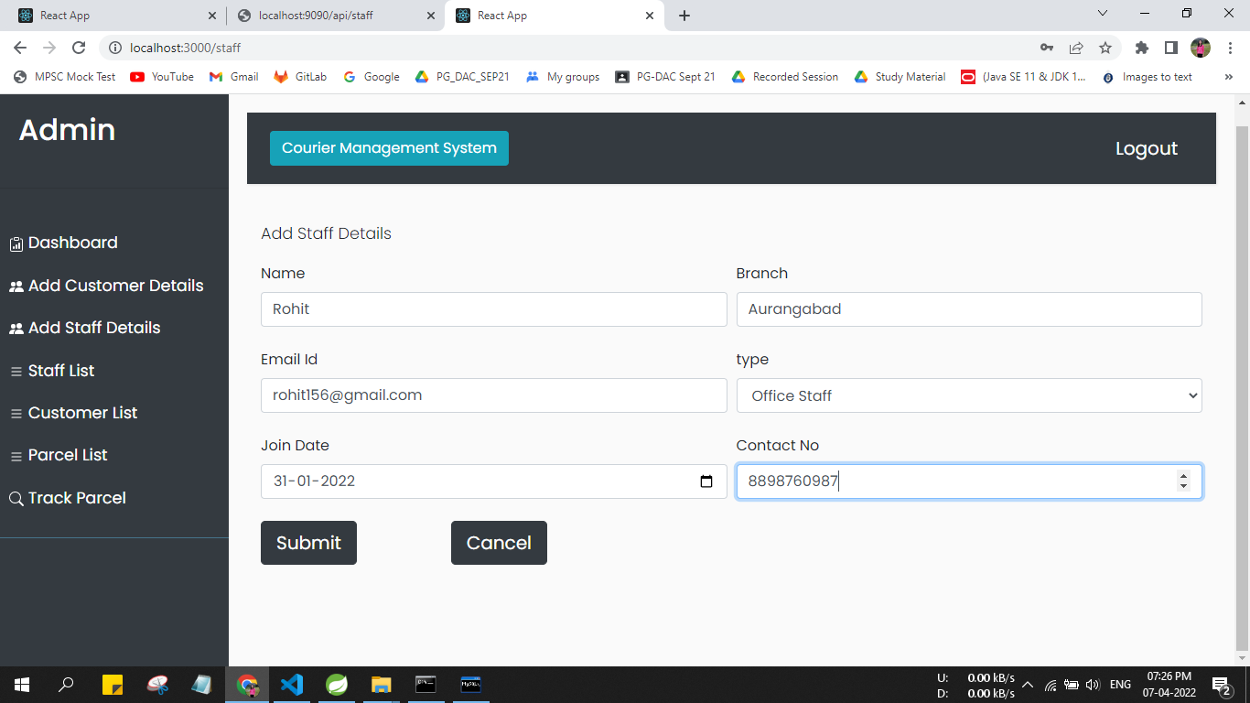
Add Staff

Slide 15
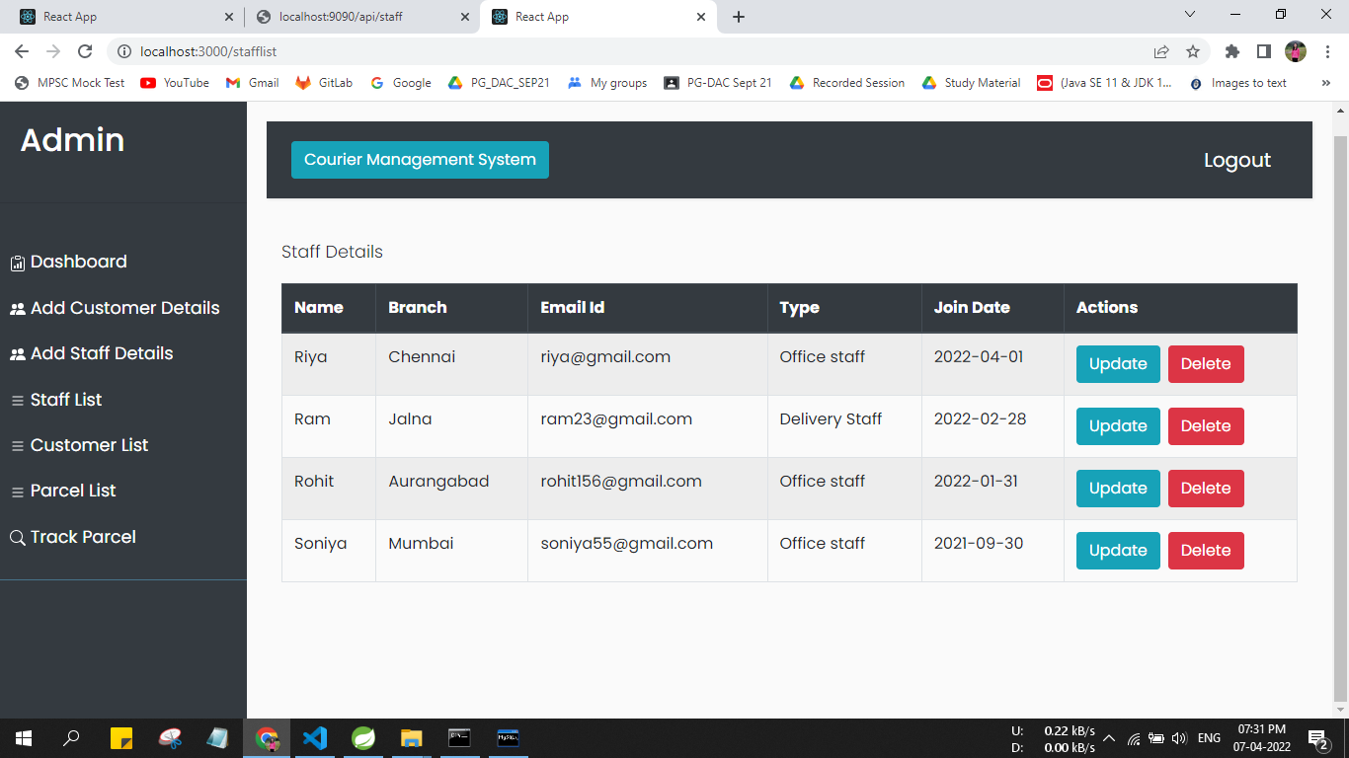
Staff List:

Slide 16
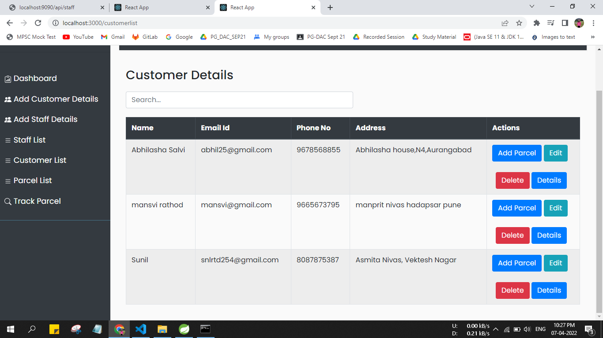
Add Customer:

Slide 17
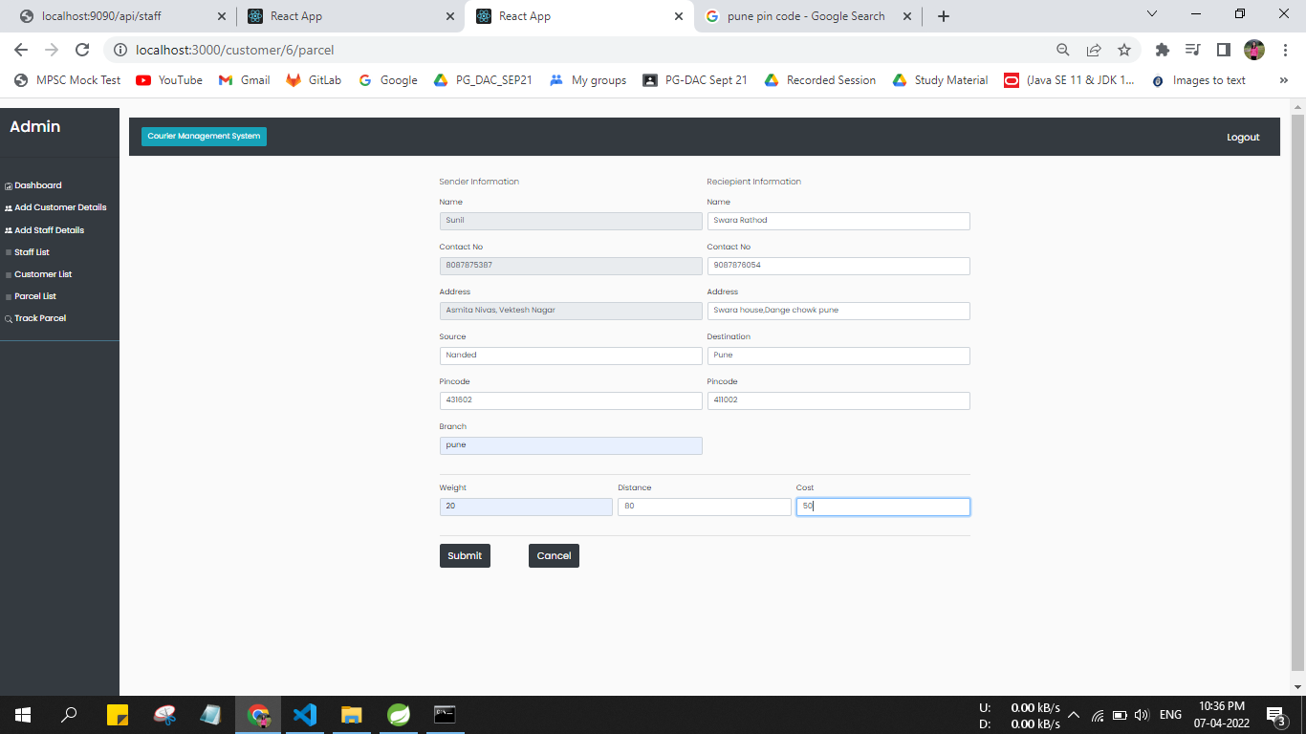
Add Parcel:

Slide 18
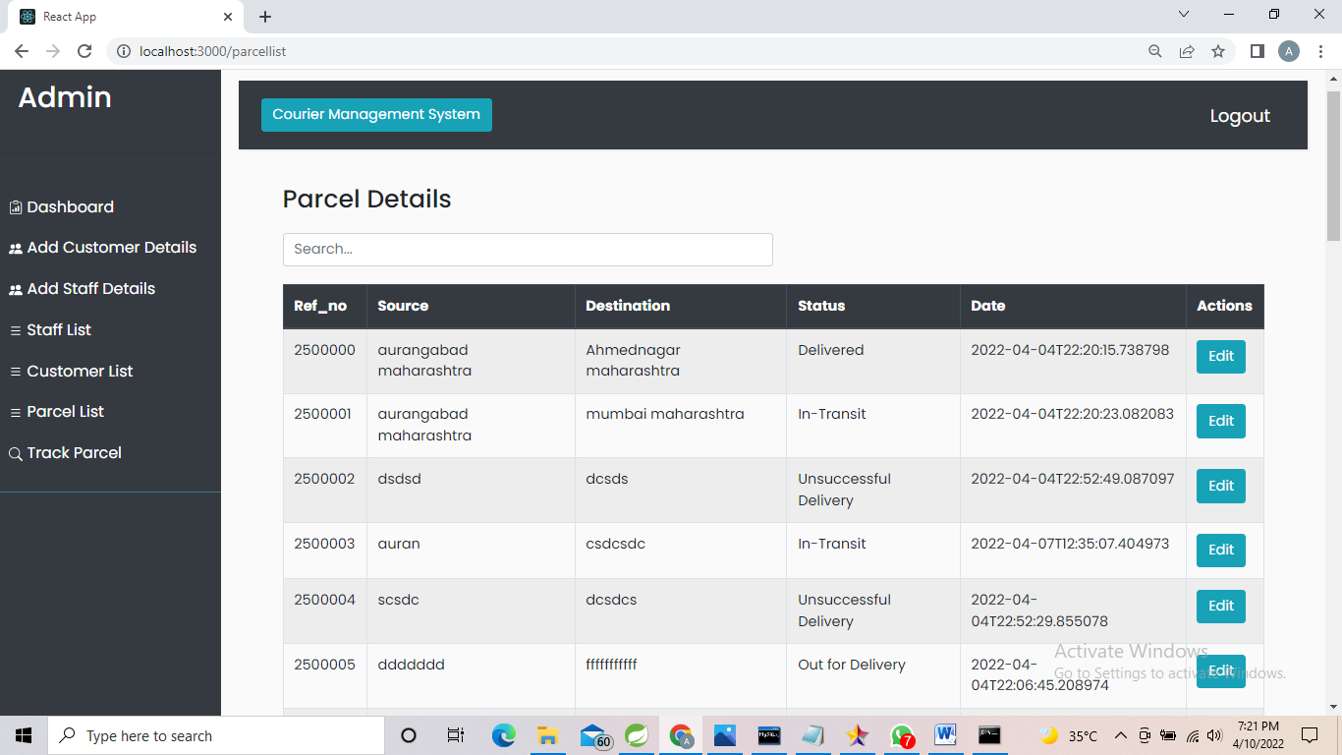
Parcel List:

Slide 19
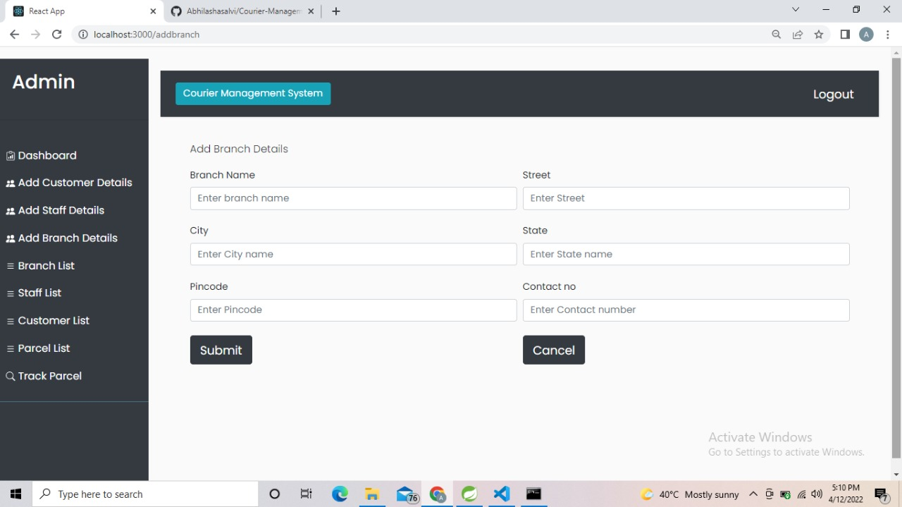
Add branch details:

Slide 20
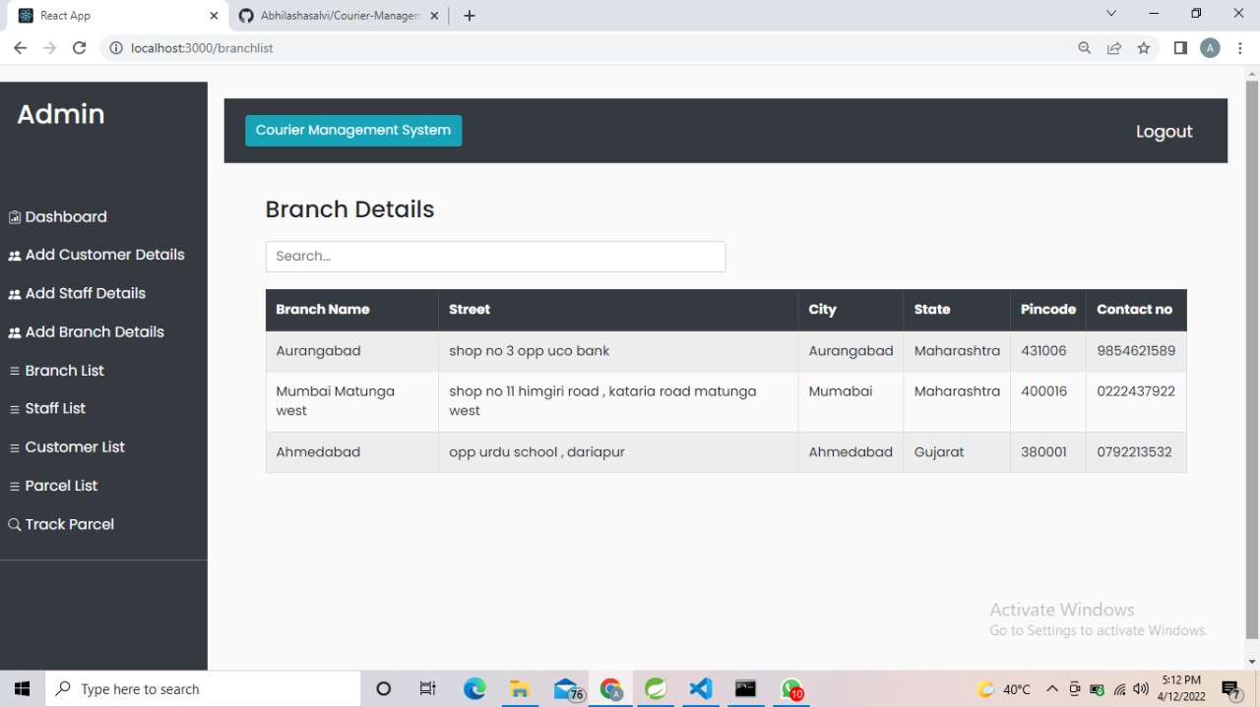
Branch details:

Slide 21
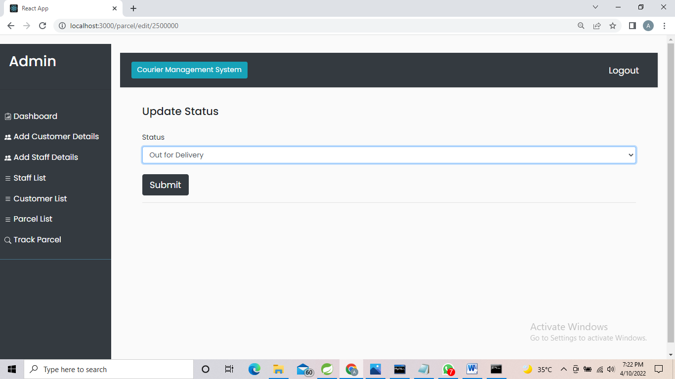
Update Status:

Slide 22
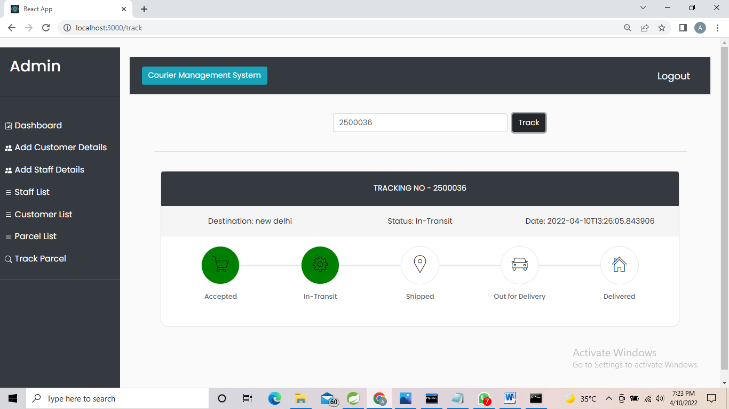
Track Parcel:

Slide 23
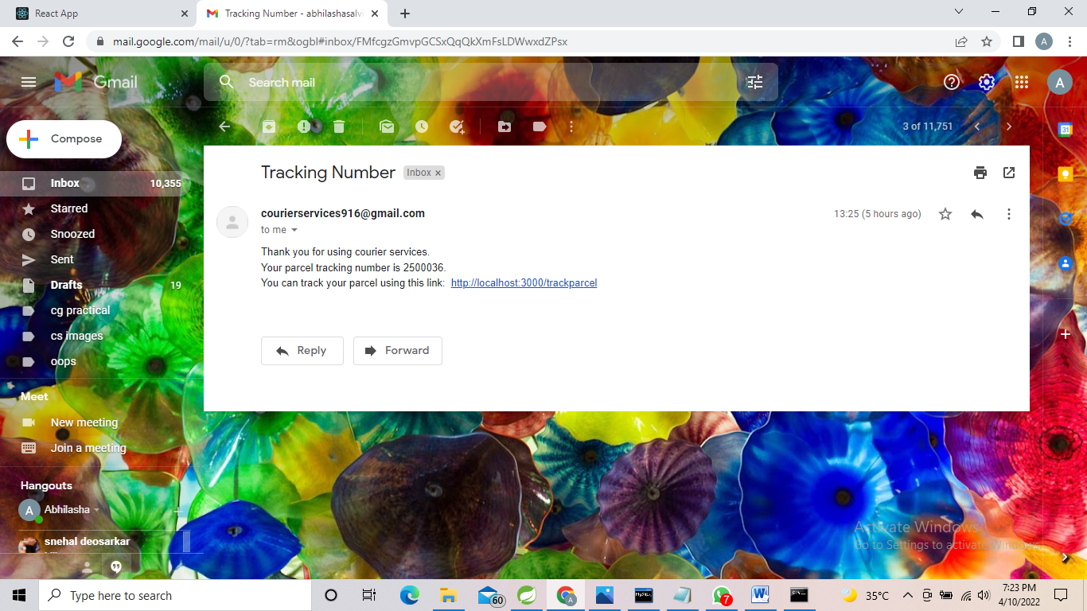
Mail is sent to customer:

Slide 24
Conclusion:
Using this project “Courier Management System” reduced as much as possible to avoid errors while entering the data. It also provides error message while entering invalid data. No formal knowledge is needed for the user to use this system.
Courier Management System, as described above, can lead to error free, secure, reliable and fast management system. It can assist the user to concentrate on their other activities rather to concentrate on the record keeping. Thus, it will help organization in better utilization of resources.

Slide 25
Future Scope:
We can give more advance software for Courier Management System including more facilities.
Customer can online book for parcel pickup.
We will host the platform on online servers to make it accessible worldwide.
Implement the backup mechanism for taking backup of codebase and database on regular basis on different servers.

Slide 26
References:
Google for problem solving
http://www.javatpoint.com/java-tutorial
http://www.tutorialspoint.com/mysql/
httpd.apache.org/docs/2.0/misc/tutorials.html
Head First Java 2nd Edition
https://www.bezkoder.com/jpa-one-to-many/

Slide 27
Thank You

